Slide 1
Netflix Movies &TV Shows 2021
File created on: 10/15/2024 1:05:40 AM

Slide 2
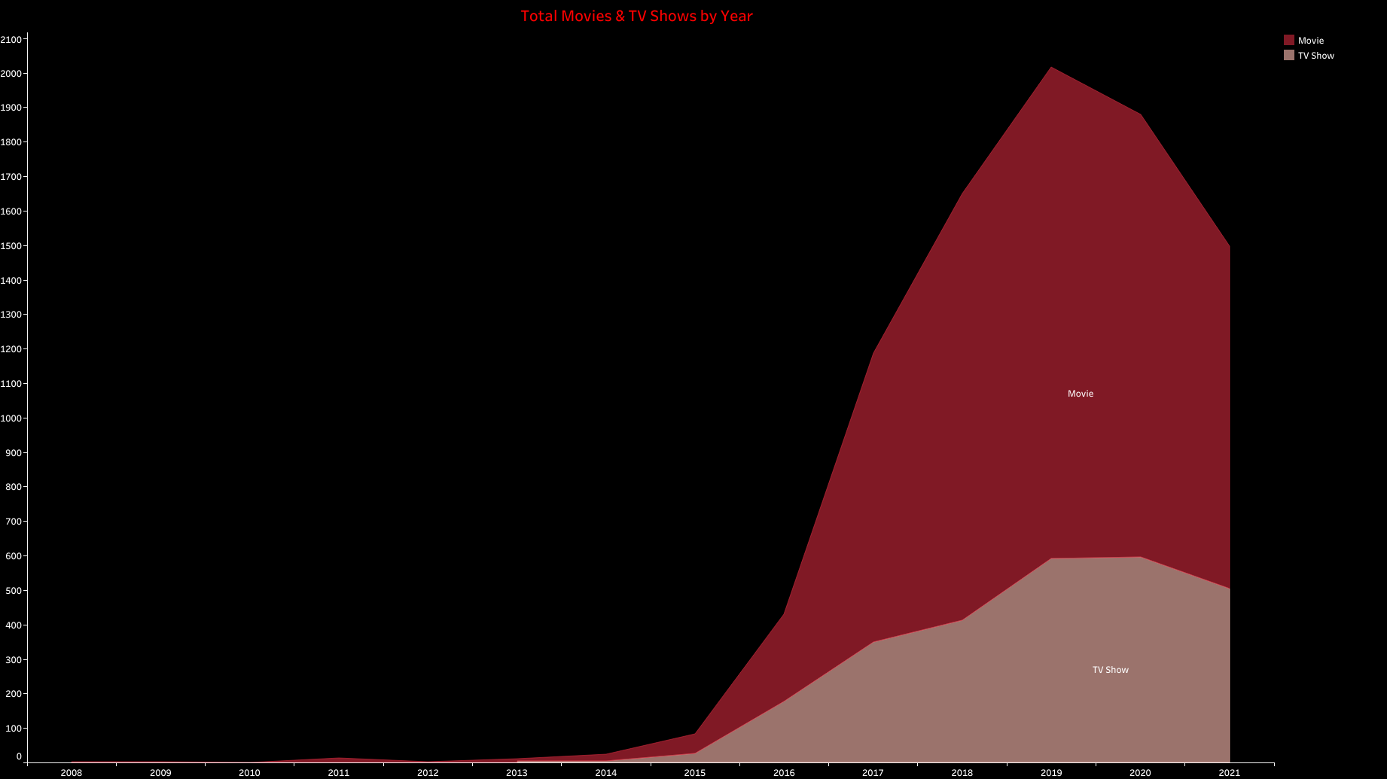

Slide 3
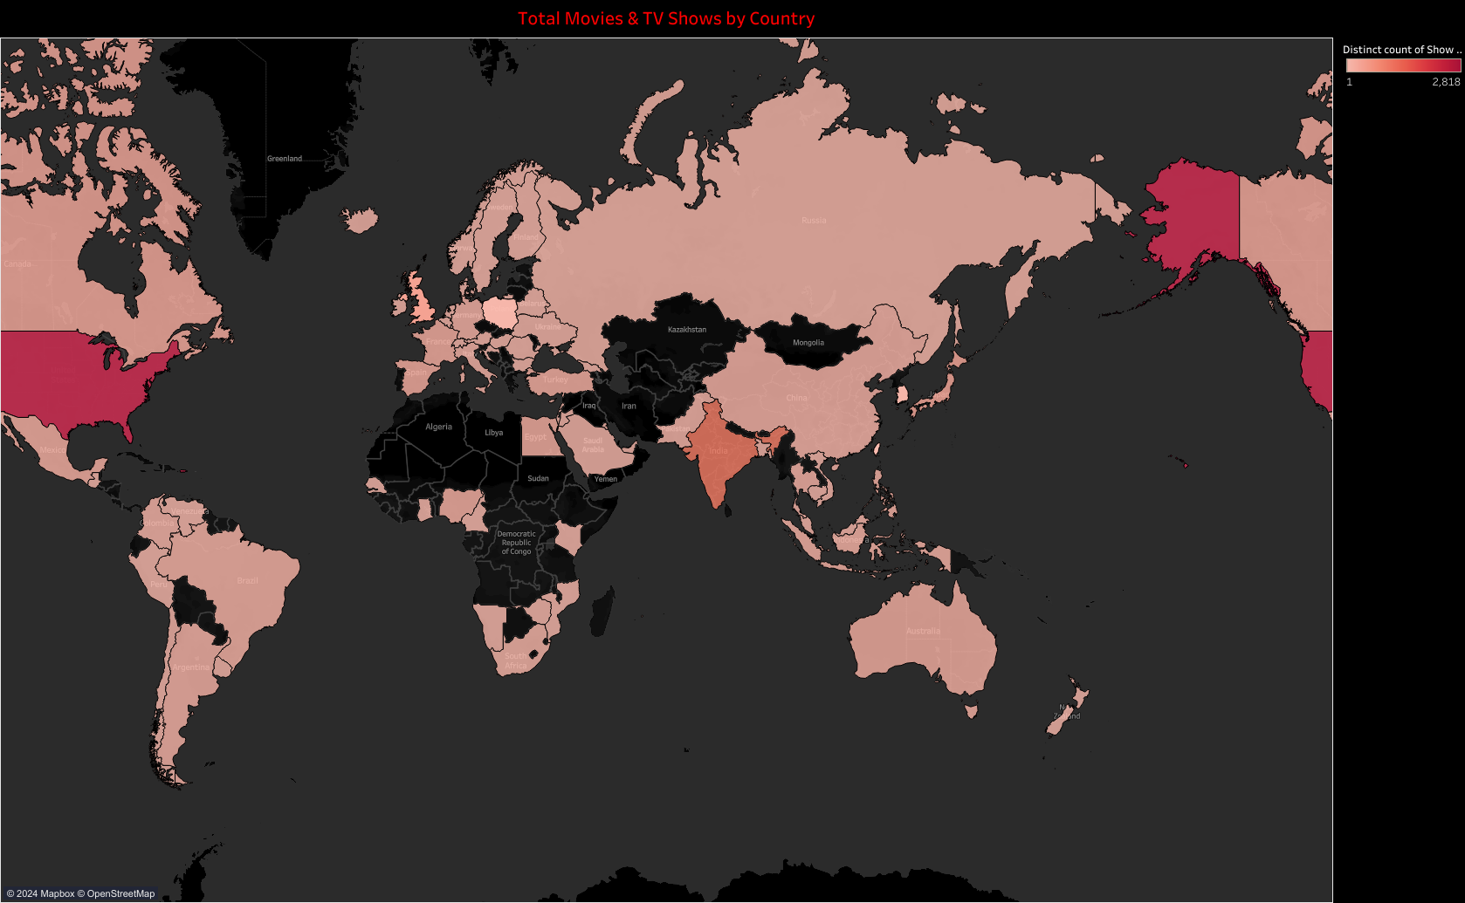

Slide 4
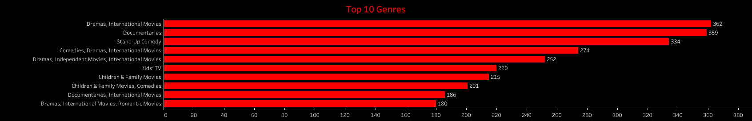

Slide 5
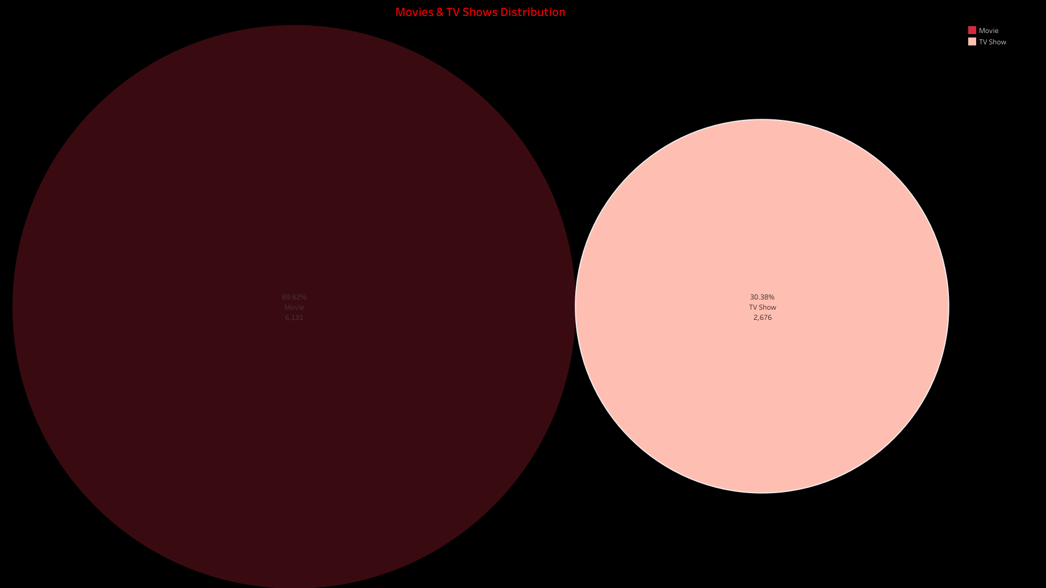

Slide 6
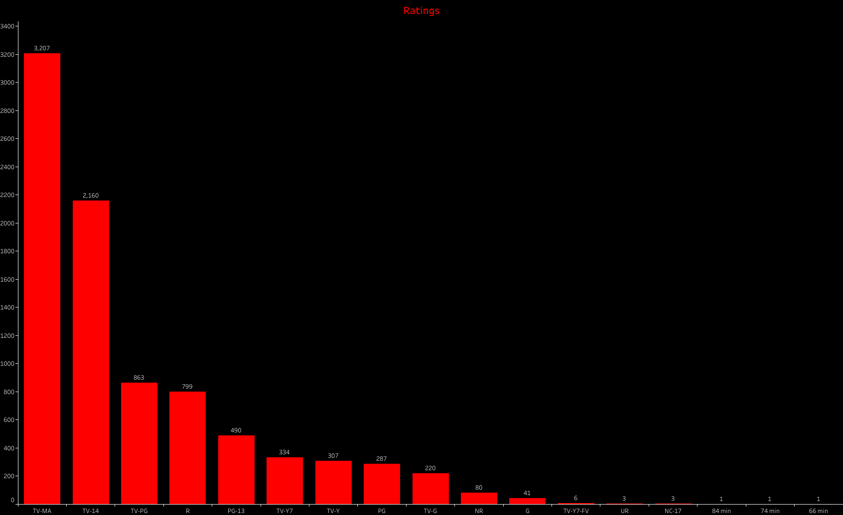

Slide 7
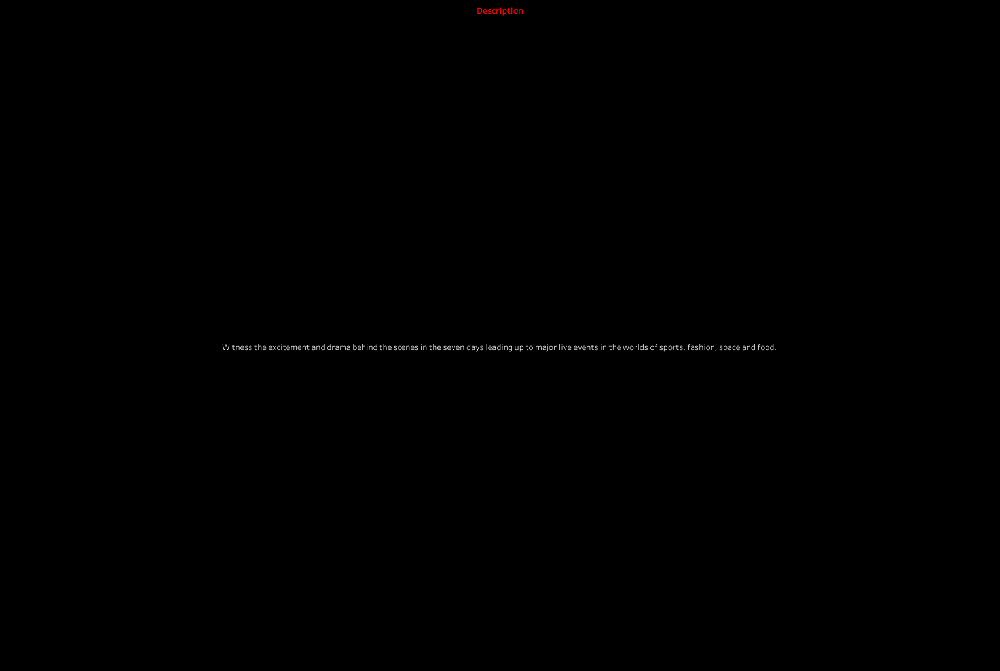

Slide 8


Slide 9


Slide 10


Slide 11


Slide 12


